Slide 1
Walking and Working Surfaces, including Fall Protection
OSHA 10-hour Outreach Training
General Industry

Slide 2
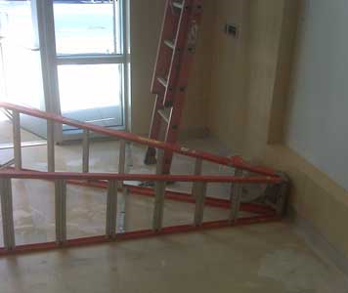
Fatal Ladder Incident
A worker was cleaning windows when he fell onto a tiled floor and hit his head. It is believed that the worker had positioned the step ladder with the rungs facing towards the windows, and that he stood backwards on the step ladder.
NIOSH In-house FACE Report 2009-01
Notes:
Summary
On January 22, 2009, a 33-year-old Hispanic worker was injured after a fall from an 8-foot step ladder. A bucket partially filled with a cleaning solution was tied with a rag to the top of the ladder. The victim was cleaning windows when he fell onto a tiled floor and hit his head. At approximately 1:08 p.m., a tile foreman on the site called 911 and stayed with the conscious victim. The victim became unresponsive and at 1:14 p.m., Emergency Medical Services (EMS) arrived on the scene. When emergency medical personnel arrived, the victim was unconscious and having seizures. EMS transported the victim to a local hospital. The following morning the worker died from his injuries. Key contributing factors identified in this investigation include: work at an elevation, the improper use of a step ladder and insufficient worker training.

Slide 3
Introduction
Slips, trips, and falls:
make up the majority of general industry accidents; and
cause 15% of all accidental deaths, second only to motor vehicle crashes.
Notes:
Falls are among the most common causes of serious work-related injuries and deaths. Employers must take measures in their workplaces to prevent employees from falling off overhead platforms, elevated work stations or into holes in the floor and walls.

Slide 4
Introduction
Lesson objectives:
Identify hazards in the workplace associated with walking and working surfaces.
Identify best practices for eliminating or controlling hazards associated with walking and working surfaces in the workplace.
Recognize employer requirements to protect workers from walking and working surface hazards.
Notes:
Terminal Objective:
Given the various walking/working surface types, the student will be able to protect themselves from walking/working hazards including fall hazards.
Enabling Objectives:
1. Identify hazards in the workplace associated with walking and working surfaces
2. Identify best practices for eliminating or controlling hazards associated with walking and working surfaces in the workplace
3. Recognize employer requirements to protect workers from walking and working surface hazards.

Slide 5
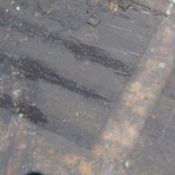

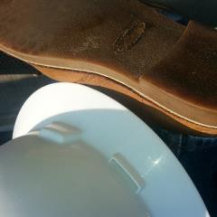

Hazards and Controls
Slip hazards:
Grease, oil, water, ice, snow, liquid spills, or polished floors
Improper footwear
Source: Photos WVU Susan Harwood
Notes:
There are many situations that may cause slips, trips, and falls, such as ice, wet spots, grease, polished floors, loose flooring or carpeting, uneven walking surfaces, clutter, electrical cords, open desk drawers and filing cabinets, and damaged ladder steps. The controls needed to prevent these hazards are usually obvious, but too often ignored, such as keeping walkways and stairs clear of scrap and debris; coiling up extension cords, lines, and hoses when not in use; keeping electrical and other wires out of the way; wearing lug soles in icy weather; clearing parking lots, stairs, and walkways in snowy weather; and using salt/sand as needed.

Slide 6
Hazards and Controls
Controlling slip hazards:
Keep walking/working surfaces as clean and dry as possible.
Make sure your footwear is as slip resistant as possible.
Require drainage for wet operations.
Clean up or mark and report spills.
Remove ice and snow frequently and regularly.
Notes:
Work surfaces should be kept clean, dry, and appropriate means to assure slip-resistance. Type of shoe-sole should match the job task to reduce possible slips. Wet operations should be properly drained. Spilled materials should be cleaned-up immediately. Ice and snow removal should be frequent and regular

Slide 7
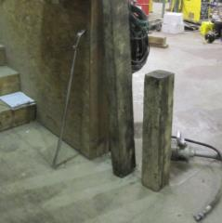
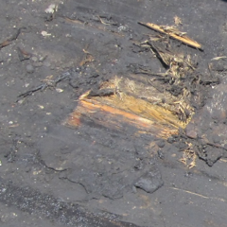
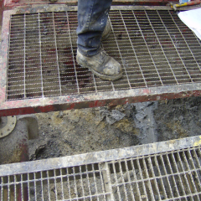
Hazards and Controls
Trip hazards:
Poor housekeeping
Loose flooring, carpeting, or uneven surfaces
Source: Photos WVU Susan Harwood
Notes:
If you don’t have the ability to fix them yourself, you should report them.

Slide 8
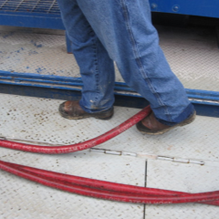
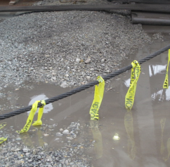
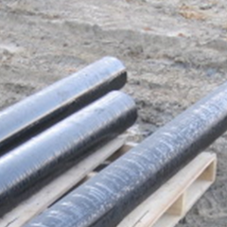
Hazards and Controls
Cords, hoses, open draws or other protruding items
Source: Photos WVU Susan Harwood

Slide 9
Hazards and Controls
Controlling trip hazards:
Aisles and passageways should be well-lit, clean, and marked.
Material storage and work-related scraps shouldn’t create trip hazards.
Trip hazards, such as loose flooring, carpeting, uneven surfaces, and protrusion hazards, should be repaired or reported.
Hoses and cables should be routed away from active work zones and walkways.
Notes:
Aisles and passageways should be well lit, clean and marked. Storage of material and equipment should not interfere with walkways. Scrap, debris, and waste should be removed often. Cords, hoses and other work-related trip hazards should be kept out of the work zone as much a practical.

Slide 10
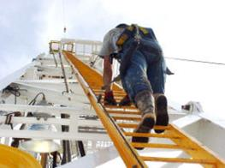
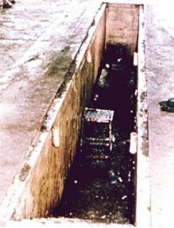
Hazards and Controls
Fall hazards:
Elevated surfaces – top of tanks, towers, machines, platforms, runways, or other elevated surfaces
Lower-level surfaces – open pits, tanks, vats, or ditches
Source of photos: OSHA
Notes:
Sometimes it is necessary to access the top of surfaces that are 4 feet or greater above the level below. These less routine situations require equal protection.
Lower-level fall hazards are present in situations where there are open pits, tanks, vats, ditches or other areas where there is an unprotected level below the walking/working surface.

Slide 11
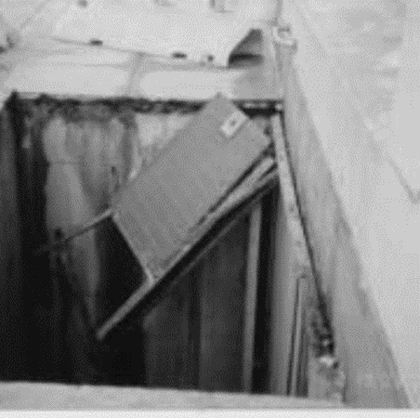
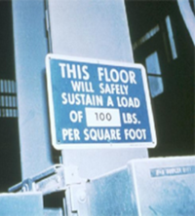
Hazards and Controls
Structural collapse
  structurally unsound surfaces, and/or
  exceeding load limits.
Photo: example of a sidewalk grate system failure
Source of photos: OSHA
Notes:
Hazard of Potential Sidewalk Grate System Failure
Accident Description
The accident occurred at a large hospital in the Boston metropolitan area. Many of the sidewalks and roadways on the hospital grounds have grates built flush with the surface to cover vaults or pits. In heavy snowstorms, snow accumulates on the grates. The hospital uses two skid-steer loaders to clear snow from roadways and sidewalks. The grates involved in this accident were made of aluminum and were bolted onto steel angle iron that was bolted into the concrete of the sidewalk vault. At the time of the accident, the age of the grates and their load capacities were unknown. The engineering drawings for the grate that were found after the accident did not reflect the conditions of the grate system as it was built.
Conclusion
Employers are required to comply with applicable OSHA standards. In addition, employers must determine whether local building codes allow heavy equipment to be operated on sidewalks and, if so, whether grate systems comply with building code provisions relating to grate system design and support capability.

Slide 12

Hazards and Controls
Controlling fall hazards
Tanks, towers, machines, and other elevated surfaces:
  It is best to engineer out
  the need to go up in the
  first place.
  Guardrails are often used,
  whether temporary
  or permanent.
  As a last resort, use a
  Personal Fall Arrest System (PFAS).
Source: OSHA
Notes:
The best way to handle these types of hazards is to engineer out the need to access such surfaces whenever possible. For example moving a tank gauge to ground level.
Often guardrails, whether temporary or permanent, can be installed.
The last line of defense would be to use a personal fall arrest system (PFAS).

Slide 13
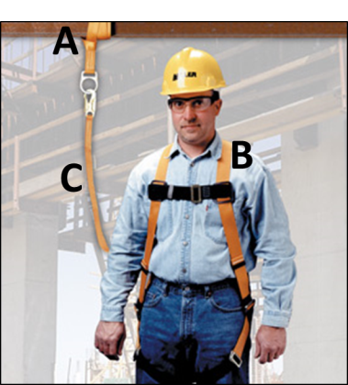
Hazards and Controls
Know the ABCs of Personal Fall Arrest Systems
Anchorages
Body harness
Components
(connectors like snaphooks or Dee-rings, connection points, lanyards, deceleration devices, lifelines, etc.)
Source: Honeywell/Miller, used with permission.
Installed, used, and maintained according to the manufacturer.
Notes:
A personal fall arrest system is a system used to safely stop (arrest) a worker who is falling from a working level. It consists of an anchorage, connectors, and a body harness. It also may include a lanyard, deceleration device, lifeline, or suitable combinations of these.

Slide 14
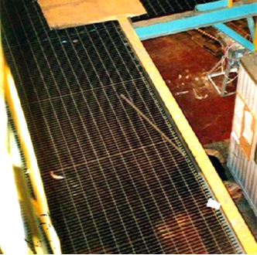
Hazards and Controls
Open-sided platforms and runways:
  Use proper guardrail system at all times.
  Platforms and runways next to dangerous operations require standard railings, regardless of height.
Source: OSHA
Notes:
Controlling Fall Hazards on open-sided platforms and runways
They require a proper guardrail system at all times.
Platforms and runways next to dangerous operations require standard railings, regardless of height.

Slide 15
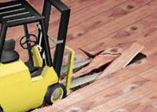
Hazards and Controls
Structural collapse:
  Ensure walking/working surfaces are structurally sound.
  Surfaces must be able to support intended/potential load, including people, equipment, and stored materials
  Load limits must be posted
Source: OSHA
Notes:
Controlling structural collapse due to lack of structural integrity or overloading walking/working surfaces –
Employers must ensure walking/working surfaces are structurally sound.
Surfaces must be able to support the intended or potential load, whether it be people, equipment, or stored materials.
Load rating limits must be marked on plates and conspicuously posted.

Slide 16
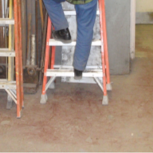
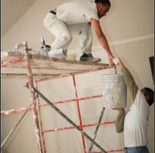
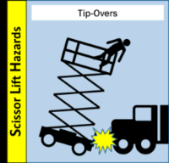
Hazards and Controls
Conditions leading to falls:
Ladders
Scaffolds and scissor lifts
Stairways
Floor and wall openings
Other elevated surfaces
Source: WVU Susan Harwood
Source: www.elcosh/org
Source: OSHA
Source: OSHA
Notes:
Conditions leading to incidents involving falls from ladders, scaffolds, scissor lifts, stairways, floor openings, or other elevated surface
Improper ladder selection, condition, or use
Improper scaffold selection, condition, or use
Improper stairway design, condition, or use
Unprotected or poorly protected floor and wall openings, open –sided platforms, or runways
Fall hazards associated with other elevated surfaces

Slide 17
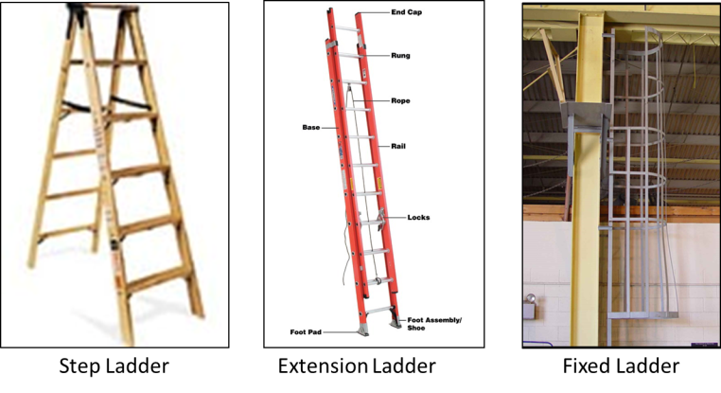
Hazards and Controls
Basic types of ladders:
Source of photos: OSHA
Notes:
Portable ladder – a ladder that can be readily moved or carried
Self-supporting – stepladder, platform ladder, tressel ladder, or other foldout types
Non-self-supporting – extension ladder or other leaning types
Fixed ladder – a ladder that cannot be readily moved or carried because it is an integral part of a building or structure.

Slide 18
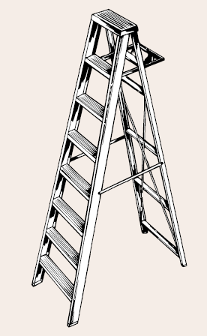
Hazards and Controls
Controlling fall hazards – ladders:
One of the leading causes of fatalities and injuries.
Ladder safety
  Use the right ladder.
  Use ladder that is free from defects.
  Use the ladder properly.
Source: OSHA

Slide 19
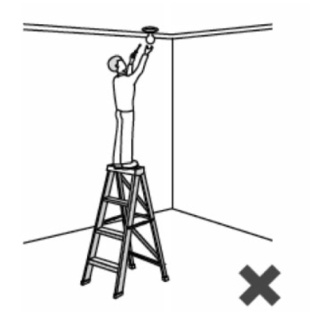

Hazards and Controls
The right ladder:
  Use the right type, length, and rating for the job.
  Never use the top two steps of a step ladder.
  Tell your supervisor if you need a longer ladder.
Wrong Ladder-too short!
Source: OSHA
Notes:
Select, used and maintained according to the manufacturer.
Read and follow all labels/markings on the ladder.
Do not exceed the maximum load rating of a ladder. Be aware of the ladder’s load rating and of the weight it is supporting, including the weight of any tools or equipment.

Slide 20
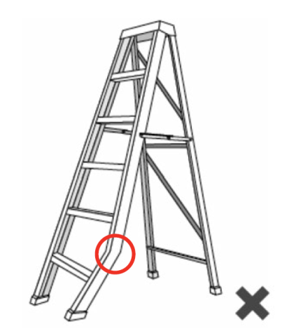

Hazards and Controls
Free from defects
  Regardless of ladder type, inspect the ladder before use.
  Do not use the ladder if it is bent or there are missing parts.
  Tell your supervisor about the defective ladder.
Source: OSHA
Notes:
Always inspect the ladder prior to using it. If the ladder is damaged, it must be removed from service and tagged until repaired or discarded.

Slide 21
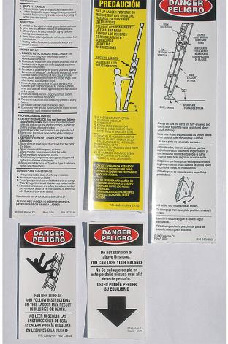
Hazards and Controls
Proper use
  Ladders must be used according to the manufacturer.
  Take the time to read the information.
  Read and follow all informational stickers and warning labels.
Source: Wernerco shares page
Notes:
Use a ladder only on a stable and level surface, unless it has been secured (top or bottom) to prevent displacement.
Do not place a ladder on boxes, barrels or other unstable bases to obtain additional height.
Wear proper footwear
Make sure the ladder is free from grease, soap and other slippery materials.
Make sure cords and hoses aren’t in the way.
A ladder placed in any location where it can be displaced by other work activities must be secured to prevent displacement or a barricade must be erected to keep traffic away from the ladder.

Slide 22
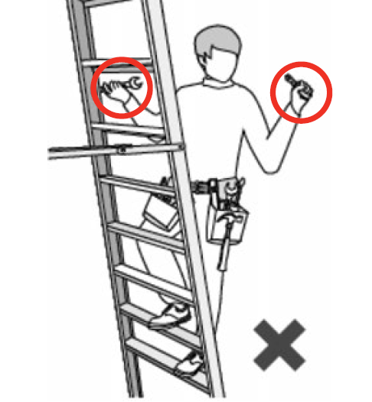
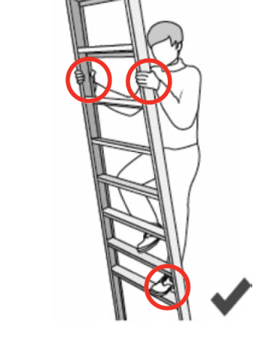

Hazards and Controls
Maintain 3 points of contact
Source: OSHA
Notes:
Always maintain a 3-point (two hands and a foot, or two feet and a hand) contact on the ladder when climbing. Keep your body near the middle of the step and always face the ladder while climbing.

Slide 23
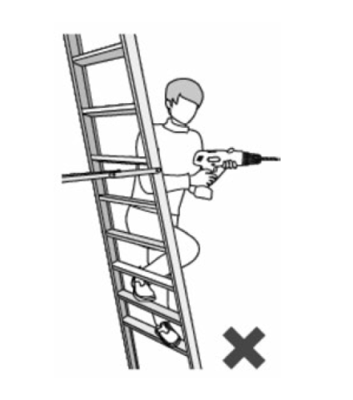

Hazards and Controls
  Maintain proper positioning.
  Do not lean away from the ladder to carry out your task.
  Always keep your weight centered between the side rails.
  Move the ladder as necessary.
Source: OSHA

Slide 24
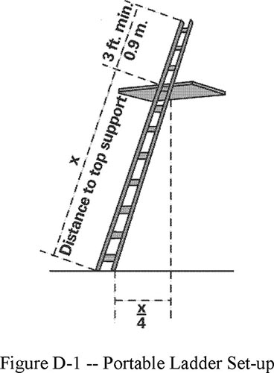
Hazards and Controls
  When using ladders to access another level, secure and extend the ladder at least 3 feet above the landing point.
  Angle ladder so the horizontal distance of bottom is ¼ the working length of the ladder.
3 feet
Source: OSHA
Notes:
An extension or straight ladder used to access an elevated surface must extend at least 3 feet above the point of support.
The proper angle for setting up a straight or extension ladder is to place its base a quarter of the working length of the ladder from the wall or other vertical surface.

Slide 25
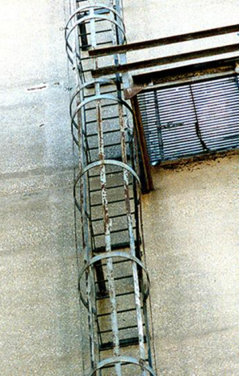
Hazards and Controls
Fixed industrial ladders
  Must be equipped with a
    Personal fall arrest system, ladder safety system (if installed on/after 12/19/18)
    Personal fall arrest system, ladder safety system, cage, or well (if installed before 12/19/18)
  PFAS or ladder safety system must provide protection throughout entire vertical distance of ladder
Source: OSHA
Notes:
Fixed Ladders
If the total length of the climb on a fixed ladder equals or exceeds 24 feet (7.3 m), the ladder must be equipped with ladder safety devices; or self-retracting lifelines and rest platforms at intervals not to exceed 150 feet (45.7 m); or a cage or well and multiple ladder sections with each ladder section not to exceed 50 feet (15.2 m) in length. These ladder sections must be offset from adjacent sections and landing platforms must be provided at maximum intervals of 50 feet (15.2 m).
Ladder Safety Devices and Related Support Systems for Fixed Ladders
The connection between the carrier or lifeline and the point of attachment to the body belt or harness must not exceed 9 inches (23 cm) in length.
Replace cages and wells with ladder safety or personal fall arrest systems on all fixed ladders over 24 feet on replacement ladders/ladder. Final deadline 12/18/2036.

Slide 26
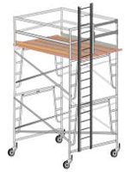
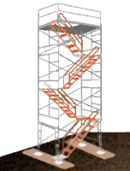
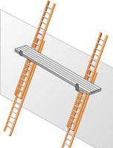
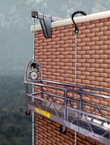
Hazards and Controls
Controlling fall hazards – scaffolds:
Scaffold-related incidents can also lead to injury and death.
Scaffold safety
  free from defects
  proper set-up
  proper use
Source: OSHA
Notes:
The Bureau of Labor Statistics' Census of Fatal Occupational Injuries (CFOI) reported 54 fatalities occurred in the year 2009 from scaffolds, staging. In a Bureau of Labor and Statistics (BLS) study, 72% of workers injured in scaffold accidents attributed the accident either to the planking or support giving way, or to the employee slipping or being struck by a falling object. All of these can be controlled by compliance with OSHA standards.

Slide 27
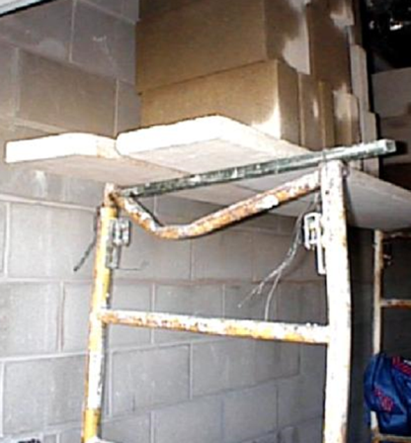
Hazards and Controls
Free from defects
  Take the time to look the scaffold over before you use it.
  Report damage if you identify defective components.
  Damaged components must be replaced before use.
Source: OSHA

Slide 28
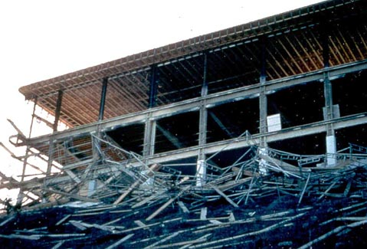

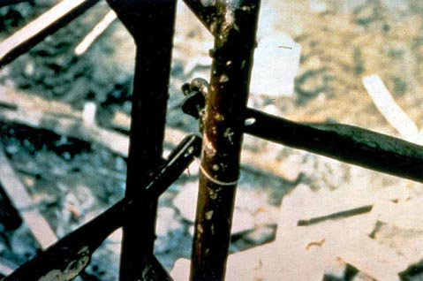
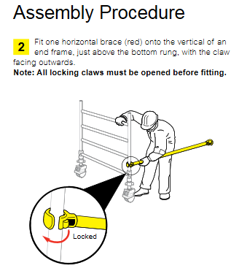
Hazards and Controls
Proper set-up
  Scaffolds must be assembled and used according to the manufacturer.
  All components such as braces and pins must be present.
  If you don’t have a copy of instructions, most can be downloaded.
Source: Wernerco shares page
Notes:
Safe scaffolding requires a solid foundation.
OSHA has standards that apply specifically to the steps that must be taken to assure a stable scaffold base.
Must be plumb and level
A scaffold becomes inherently unstable once its height is four times its minimum base dimension.
To prevent tipping, it must be restrained by guys, ties, or braces.
You can also add outriggers to widen the base.

Slide 29
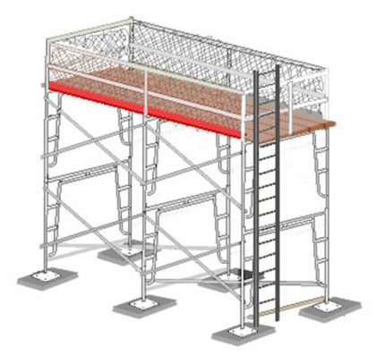
Hazards and Controls
  Each platform must be fully planked or decked between the front uprights and the guardrail supports.
  You should not be exposed to a fall hazard due to partial decking.
Source: OSHA
Notes:
Scaffolds must be fully planked with scaffold grade planking or platforms.

Slide 30
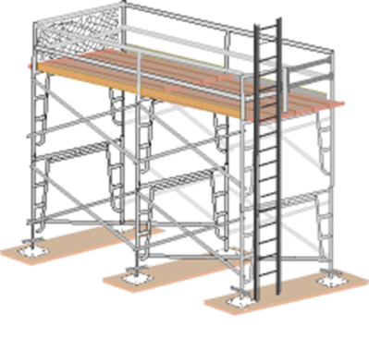
Hazards and Controls
  Fall protection consists of either a guardrail system or a personal fall-arrest systems (PFAS).
  It must be provided on any scaffold 10 feet or more above a lower level.
Source: OSHA
Notes:
Guard rails, mid-rails, and toe boards must be installed on all open sides of platforms more than 10 feet above grade.
Mesh must be installed between the toe board and top-rail if tools of materials are higher than the toe board or workers must work or pass under the scaffolding.

Slide 31
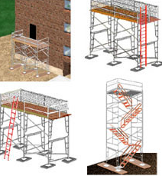
Hazards and Controls
Safe access
  Preventing falls begins with safe access.
  You are most vulnerable to fall hazards when climbing on or off a scaffold.
  Your employer is required to provide safe scaffold access.
Source: OSHA
Notes:
A safe means of access such as a ladder must be provided.

Slide 32
Hazards and Controls
Proper use
  Make sure you are a properly trained scaffold user.
  Use scaffolds according to the manufacturer.
  Follow your company’s scaffold safety policy.
  Report scaffold-related safety issues to your employer.

Slide 33
Hazards and Controls
  Never climb the bracing.
  Never climb the frame unless designed to be a ladder.
  Don’t carry tools or materials while climbing.
  Never use a ladder or other device to increase your reach from platform.

Slide 34
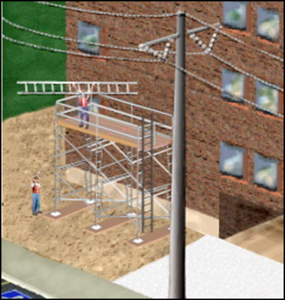
Hazards and Controls
  Make sure the scaffold system, your tools, and the materials your are working with stay at least 10 feet away from powerlines.
  3 feet from insulated lines.
Source: OSHA

Slide 35
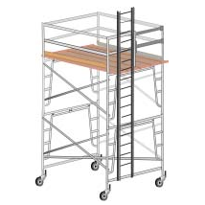
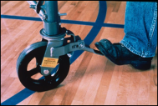
Hazards and Controls
Mobile scaffolds - additional concerns:
  All casters must be locked when occupied.
  They can not be moved while occupied.
  All casters must have retainer pins.
Source: OSHA
Notes:
Mobile scaffolds cannot be moved while workers are on them.
All wheel casters on mobile scaffolds must be locked while accessing work platform and during work activities.

Slide 36
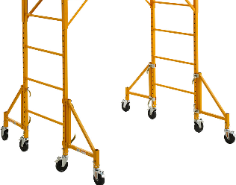
Hazards and Controls
  The height of the platform must never exceed 4 times the minimum base dimension.
  Outriggers may be necessary to increase the minimum base dimension.
Source: Wernerco shares page
Notes:
Mobile scaffolds must never exceed the 4:1 ratio.

Slide 37
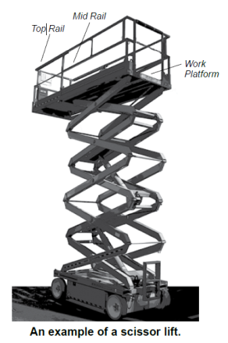
Hazards and Controls
Controlling fall hazards – scissor lifts:
OSHA’s investigations found that most injuries and fatalities involving scissor lifts were the result of employers not addressing:
  Fall Protection
  Stabilization
  Positioning
Source: OSHA
Notes:
Only trained workers should be allowed to use scissor lifts, and employers should make sure that those workers show that they can use a scissor lift properly.
Over a one-year period, OSHA investigated ten preventable fatalities and more than 20 preventable injuries resulting from a variety of incidents involving scissor lifts.
Although scissor lifts present hazards similar to scaffolding when extended and stationary, using scissor lifts safely depends on considering equipment capabilities, limitations and safe practices.

Slide 38
Hazards and Controls
Fall protection
  Check to see that a guardrail system is in place before working on the scissor lift.
  Only stand on the work platform; never stand on the guardrails.
  Keep work within easy reach to avoid leaning away from the scissor lift.
Source: OSHA
Note: Some manufacturers require a PFAS in addition to the unit’s guardrails.
Notes:
Employers should train workers to:
Check to see that a guardrail system is in place before working on the scissor lift.
Only stand on the work platform; never stand on the guardrails.
Keep work within easy reach to avoid leaning away from the scissor lift.

Slide 39
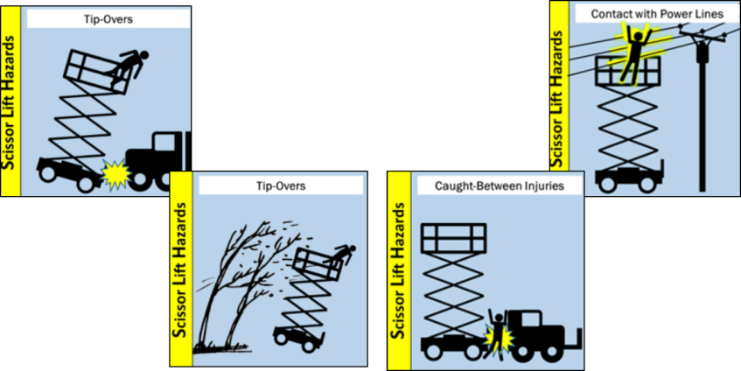
Hazards and Controls
Stabilization and positioning
Source: OSHA
Notes:
Employers should ensure that scissor lifts are stable and will not tip over or collapse.
Caution: Wind Can Make Extended Scissor Lifts Unstable
During the Fall 2010 college football season, a student who was also an employee of the University of Notre Dame was killed while filming the school’s football team practice from a scissor lift. Reportedly, the untrained worker raised the lift over 39 feet to film the practice. The wind gusts that day were more than 50 miles per hour. The high winds blew the lift over, killing the worker.
Isolate the scissor lift or implement traffic control measures.
Select work locations with firm level surfaces.
Outdoor use is generally limited to wind speeds below 28 miles per hour per manufacturer requirement. However, some manufacturers may have different wind speed requirements. (https://www.osha.gov/Publications/OSHA3842.pdf)
Do not approach electrical power sources (e.g., power lines, transformers) by at least 10 feet
Use ground guides (spotters) when operating or moving the scissor lift around the workplace.
Positioning the scissor lift to avoid electrocution, arc flash, and thermal burns is important for safely using scissor lifts near energized power lines.

Slide 40
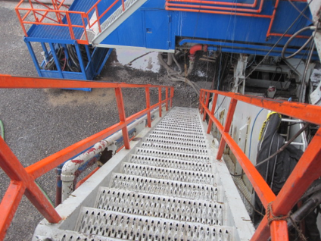
Hazards and Controls
Controlling fall hazards – stairs:
Often stair-related hazards can be overlooked.
Stair safety comes down to proper
  Design & Construction
  Condition
  Use
Source: WVU Susan Harwood
Notes:
Proper design, construction, condition and use are crucial for controlling stairway-related hazards.

Slide 41
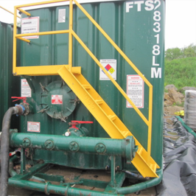
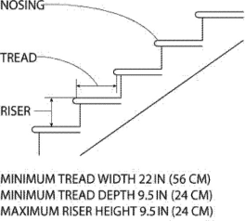
Hazards and Controls
Proper design/construction
  Fixed industrial stairs must be:
    strong enough to handle a minimum 1,000 lb. live load;
    at least 22 inches wide;
    installed at angles between 30-50 degrees; and
    no more than ¼ inch variation.
Source: OSHA
Source: WVU Susan Harwood
Notes:
Fixed industrial stairs (stairs around tanks, machinery, equipment, platforms, pits etc.) must be strong enough to carry five times the anticipated live load with a minimum of 1,000 lbs.
Fixed industrial stairs must be at least 22 inches wide
Fixed industrial stairs must be installed at angles between 30-50 degrees.
Fixed industrials stairs must have at least 7 feet of vertical clearance above any tread. All stairs require proper lighting for safe use

Slide 42
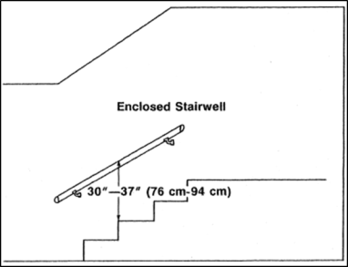

Hazards and Controls
  Handrails are required when there is 4 or more risers.
  Mainly to be used on the right side as you descend.
  Allows you to maintain three points of contact.
Notes:
Every flight of stairs with four or more risers must have standard stair railings on all open sides or standard handrails if stairs are enclosed (preferably on the right side descending).

Slide 43

Hazards and Controls
  Stair rails prevent falls from open sides.
  Stair rail system must be present on the unprotected sides and edges (open stairs).
  Stair rails are required when there is 4 or more risers.
Notes:
Every flight of stairs with four or more risers must have standard stair railings on all open sides or standard handrails if stairs are enclosed (preferably on the right side descending).

Slide 44


Hazards and Controls
Condition
  Fixed industrial stairs must be maintained in good shape
  These stairs are uneven and unpredictable.
  Report stair-related defects
  What else is wrong?
Notes:
All stairs require proper lighting for safe use.
All stairs should be inspected on a regular basis for condition and housekeeping-related hazards.
Items should never be placed, left, or stored on stairs.
These stairs also require railing on both sides.

Slide 45

Hazards and Controls
Proper use
  Maintain at least three (3) points of contact.
  Do not run up or down stairs.
  Do not carry heavy objects, only light loads.
  Do not jump the last few steps.
Source: WVU Susan Harwood
Notes:
Even a good set of stairs can be the site of a fall if not properly used

Slide 46

Hazards and Controls
  Items should never be placed or stored on stairs.
  Stairs should be inspected on a regular basis.
  Remove items to ensure no one gets hurt.
Source: OSHA

Slide 47

Hazards and Controls
Common fall hazards:
Floor and wall openings
Open-sided platforms and runways
Notes:
Floor openings, floor holes, wall openings and open-sided platforms or runways are hazardous situations. Properly protecting floor and wall openings and elevated platforms is crucial in eliminating fall hazards
1910.21(a)(1)
"Floor hole." An opening measuring less than 12 inches but more than 1 inch in its least dimension, in any floor, platform, pavement, or yard, through which materials but not persons may fall; such as a belt hole, pipe opening, or slot opening.
1910.21(a)(2)
"Floor opening." An opening measuring 12 inches or more in its least dimension, in any floor, platform, pavement, or yard through which persons may fall; such as a hatchway, stair or ladder opening, pit, or large manhole. Floor openings occupied by elevators, dumb waiters, conveyors, machinery, or containers are excluded from this subpart
1910.21(a)(11)
"Wall opening." An opening at least 30 inches high and 18 inches wide,in any wall or partition, through which persons may fall; such as a yard-arm doorway or chute opening
1910.21(a)(4)
"Platform." A working space for persons, elevated above the surrounding floor or ground; such as a balcony or platform for the operation of machinery and equipment.
1910.21(a)(5)
"Runway." A passageway for persons, elevated above the surrounding floor or ground level, such as a footwalk along shafting or a walkway between buildings

Slide 48


Hazards and Controls
Controlling fall hazards – floor openings:
Unguarded openings like this must never exist.
They require a proper cover or guardrail system at all times.
Posting a “guard” to monitor an opening like this for temporary access is permitted.
Source: OSHA
Notes:
Floor openings, such as those needed for stairways must protected.
Standard railings must be present on all sides of the opening except at the stairway entrance.
A standard railing is 42 inches high and made up of a top rail, mid rail, vertical posts, and toe boards to prevent struck-by hazards to those using the stairs.
Floor openings may be guarded by covers instead. When routine travel over the opening is necessary, often a cover is used, such as a trap-door.
When the floor opening cover is opened, either a temporary guardrail must be in place or the opening must be constantly attended by someone until closed.

Slide 49

Hazards and Controls
Controlling fall hazards – wall openings
Wall openings from which there is a drop of more than 4 feet must be guarded.
They require a proper guardrail system, like this one, at all times.
Source: OSHA
Notes:
Every open-sided platform or wall opening that is 4 ft. or move above the next level must be protected by a standard railing.

Slide 50
Hazards and Controls
Guardrail systems:
Standard railing: consists of top rail, mid-rail, and posts. Height from the upper surface of top rail to floor level is 42” (+/− 3”).
Mid-rail height is 21 inches.
Standard toeboard:
3.5” high, with not more than ¼” clearance above the floor.
Source: OSHA
Notes:
1910.29(b)
Guardrail systems. The employer must ensure guardrail systems meet the following requirements:
1910.29(b)(1)
The top edge height of top rails, or equivalent guardrail system members, are 42 inches (107 cm), plus or minus 3 inches (8 cm), above the walking/working surface. The top edge height may exceed 45 inches (114 cm), provided the guardrail system meets all other criteria of paragraph (b) of this section (see Figure D-11 of this section).
1910.29(b)(2)
Midrails, screens, mesh, intermediate vertical members, solid panels, or equivalent intermediate members are installed between the walking-working surface and the top edge of the guardrail system as follows when there is not a wall or parapet that is at least 21 inches (53 cm) high:
1910.29(b)(2)(i)
Midrails are installed at a height midway between the top edge of the guardrail system and the walking-working surface;
1910.29(b)(2)(ii)
Screens and mesh extend from the walking/working surface to the top rail and along the entire opening between top rail supports;
1910.29(b)(2)(iii)
Intermediate vertical members (such as balusters) are installed no more than 19 inches (48 cm) apart; and
1910.29(b)(2)(iv)
Other equivalent intermediate members (such as additional midrails and architectural panels) are installed so that the openings are not more than 19 inches (48 cm) wide.
1910.29(k)(1)
The employers must ensure toeboards used for falling object protection:
1910.29(k)(1)(i)
Are erected along the exposed edge of the overhead walking-working surface for a length that is sufficient to protect employees below.
1910.29(k)(1)(ii)
Have a minimum vertical height of 3.5 inches (9 cm) as measured from the top edge of the toeboard to the level of the walking-working surface.
1910.29(k)(1)(iii)
Do not have more than a 0.25-inch (0.5-cm) clearance or opening above the walking-working surface.
1910.29(k)(1)(iv)
Are solid or do not have any opening that exceeds 1 inch (3 cm) at its greatest dimension.

Slide 51
Employer Requirements
To prevent employees from being injured from falls, employers must:
Guard every floor hole into which a worker can accidentally walk.
Provide a guardrail and toeboard around every open-sided platform, floor or runway that is 4 feet or higher off the ground or next level.

Slide 52
Employer Requirements
Regardless of height, if a worker can fall into or onto dangerous machines or equipment, employers must provide guardrails and toeboards.
Other means of fall protection that may be required on certain jobs include safety harness and line, safety nets, stair railings and handrails.

Slide 53
Employer Requirements
Provide working conditions that are free of known dangers.
Keep floors in work areas in a clean and sanitary condition.
Select and provide required personal protective equipment at no cost to workers.
Train workers about job hazards in a language that they can understand.

Slide 54



Hazard Recognition
Identify hazards and what should be done to control them.
Source of photos: WVU
Notes:
Photo left: Unprotected vehicle service pit.
Photo middle: Uneven walking surface.
Right photo: Trip hazards on shop floor.
Have students propose solution for each.

Slide 55



Hazard Recognition
Identify hazards and what should be done to control them.
Source : WVU
Source: OSHA
Source: WVU
Notes:
Photo left: Improper ladder use. Using top step.
Photo middle: Improper ladder set up. Unstable base.
Right photo: Improper ladder use. Photo shows an employee exposed to a fall hazard while reaching down with his foot to access the 8 foot step ladder.
Have students propose solution for each.

Slide 56



Hazard Recognition
Identify hazards and what should be done to control them.
Source of photos: OSHA
Notes:
Photo left: Welder on top of tank without fall protection.
Photo middle: Open sided floor. Sheet metal not attached to vertical steel beams. Sheet metal pushed away from floor allowing employee to fall
Right photo: This photo shows pit with ladder access to a vertical conveyor system. The pit's opening is 20 inches by 24 inches with a depth of 11 feet 6 inches.
Have students propose solution for each.

Slide 57



Hazard Recognition
Identify hazards and what should be done to control them.
Source of photos: OSHA
Notes:
Photo left: Ladder not provided with ladder climbing device, offset landings every 20', or cage with a maximum length of 30'.
Photo middle: Missing section of ladder cage.
Right photo: Improper fixed ladder design, not enough toe clearance.
Have students propose solution for each.

Slide 58



Hazard Recognition
Identify hazards and what should be done to control them.
Source: OSHA
Source: WVU
Source: OSHA
Notes:
Photo left: This photo depicts a working platform accessed by employees that was measured at 53.5 inches above the ground and did not have guardrails. Also depicted are two stair systems with 4 or more risers that were not equipped with handrails.
Photo middle: The photo shows the lack of a handrail and treads and risers that are not uniform
Right photo: Missing toe board
Have students propose solution for each.

Slide 59



Hazard Recognition
Identify hazards and what should be done to control them.
Source of photos: OSHA
Notes:
Photo left: Poor scaffold foundation-mud and unstable objects.
Photo middle: Scaffold not fully planked. No fall protection.
Right photo: Improper access worker is climbing frame.
Have students propose solution for each.

Slide 60
Knowledge Check
Slips, trips, and falls make up what percent of all accidental deaths?
    2%
    15%
    36%
    50%
  Answer: b. 15%

Slide 61
Knowledge Check
What is the easiest and most accurate way to use a portable ladder according to the manufacturer?
    Contact the manufacturer via cell phone
    Download the material from the internet.
    Read and follow all warning labels and stickers.
    Ask a fellow worker.
  Answer: c. Read and follow all warning
  labels and stickers.

Slide 62
Knowledge Check
When using a portable ladder to access another level, which statement is true?
    A step ladder may be used if long enough.
    Portable ladders may never be used.
    The ladder should be secured and extend 3 feet above the level you are accessing.
    Carrying tools and materials is permitted.
  Answer: c. The ladder should be secured
  and extend 3 feet above the level
  you are accessing.

Slide 63
Knowledge Check
The maximum work level height of a free-standing scaffold’s platform should never exceed ___ times the minimum base dimension.
    2
    3
    4
    5
  Answer: c. 4
Notes:
1910.23(e)(1)(vi)
The maximum work-surface height of mobile ladder stands and platforms does not exceed four times the shortest base dimension, without additional support. For greater heights, outriggers, counterweights, or comparable means that stabilize the mobile ladder stands and platforms and prevent overturning must be used;

Slide 64
Knowledge Check
Which best describes a safe scaffold?
    Placed on a firm foundation and is plumb and level
    Has proper access and is fully decked
    Has proper guardrail system
    All of the above
  Answer: d. All of the above

Slide 65
Knowledge Check
Scissor lifts rated for outdoor use are generally limited to wind speeds below __.
    28 MPH
    50 MPH
    60 MPH
    75 MPH
  Answer: a. 28 MPH
Notes:
https://www.osha.gov/Publications/OSHA3842.pdf
“Use the scissor lift outside only when weather conditions are good. Scissor lifts rated for outdoor use are generally limited to wind speeds below 28 miles per hour.”

Slide 66
Knowledge Check
The height of a proper guardrail system is __ (+/− 3”) from the walking/working surface.
    30 inches
    42 inches
    60 inches
    None of the above
  Answer: b. 42 inches

